Slide 1

Project on Bank Management system
Submitted by:
PAYAL
CSE 3rd year
15001001037

Slide 2
Content
Problem Definition
Overview of project
Why JAVA ?
Why MYSQL ?
Hardware requirements
Software requirements
Working of the project
Data Flow Diagram
E-R Diagram

Slide 3
Problem Statement ?
The issue is to resolve the basic services to manage bank accounts at a bank. This system would be able to maintain information and able to keep records of that particular event.

Slide 4
Overview Of Project
The Bank Management System is an application for maintaining a person’s account in a bank . The system provides access to the user to create an account, deposit / withdraw money from his account, and also to view reports of all accounts present.

Slide 5
Why JAVA ?
First of all JAVA is a open source programming language created by SUN Microsoft .
Its source code is available for free inside every JDK(Java Development Kit ).
JAVA is platform independent.
JAVA is a secure language.
JAVA is fast because of JIT compiler(Just In Time Compiler).

Slide 6
WHY MySql ?
MYSQL is a freely available open source relational database management system.
MYSQL database server is very fast, reliable, scalable and easy to use.

Slide 7
Hardware Requirements
To run or start my project you must have these following hardware devices :
RAM: 128 MB
Disk Space: 124 MB for JRE; 2MB for java update
Processor: Minimum Pentium 4 processor or more.

Slide 8
Software Requirement
To start or run this software we must have
these following software:
Java Runtime environment (JRE)1.6.0 or above
Xammp Server (For Mysql)
Netbeans IDE 8.2

Slide 9
Working of the Project
The work is based on the type of the role of the
user whether he/she is Admin , Manager or a
general user.
Authentication:
Login: The user can be admin, manager and general user. He / She has to fill the username and password and click to login button.
If credentials are correct then he/she will be directed to next page and if not, error message is displayed.

Slide 10
Admin: This feature is only available for admin use. No other can access this .There are special function he / she can do as given below :
Add User
View All Users
Delete User
Delete All Users
File: There are further more options are given below :
New Account : Admin and manager can add new account.
Change Password
Exit.

Slide 11
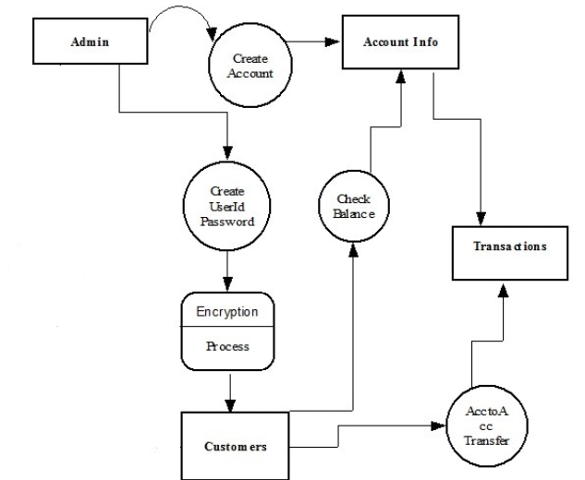
Data Flow Diagram

Slide 12
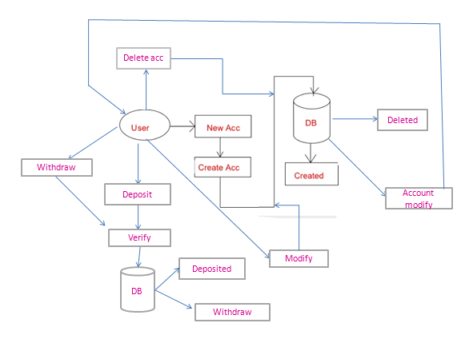
E-R Diagram

Slide 13
Edit : In edit there are further more options given below:
Deposit
Withdraw
Modify Account
Delete Account
Delete All Account
View: In view there are further more options given below:
Account information
Balance sheet
All Transactions
Navigate all account Holders
All account holders List

Slide 14
Format : This feature is available for all the users . Users can change their background color easily.
Window : By this user can close the activated windows on the screen. There are two options
Close activated window : It will close the current activated window .
Close all windows : It will close all the activated windows on the screen.

Slide 15
Help : In help there are some shortcut keys are available for direct functioning . Keys like:
Ctrl + N: To create new account.
Ctrl + P: To change password.
Alt + D: To deposit money.
Alt + W: To withdraw money.
Ctrl + M: To modify account.
Ctrl + D: To delete account.

Slide 16
THANK YOU

